Slide 1

Mobile Testing Appium

Slide 2
Appium Intro

Slide 3

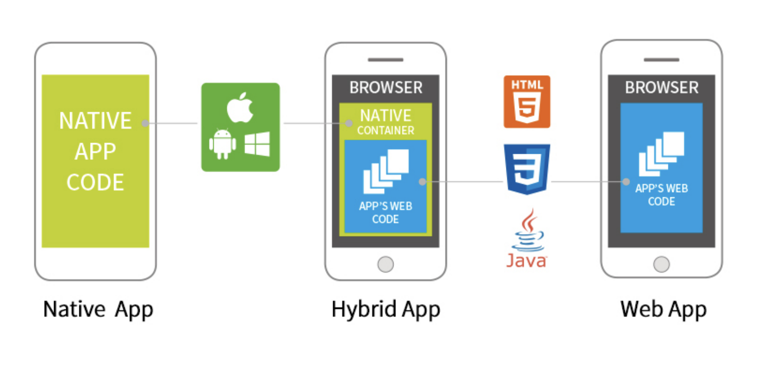

What is Appium?
Appium is an API, that uses Selenium capabilities, to automate iOS and Android devices such as; phones, tablets and even TVs.
Multiple platforms and multiple languages are supported. (Java, Python, JS and Ruby)
It is using XCUITest Driver for İOS platforms and UiAutomater2 Driver for Android platforms.
We can automate Native, Hybrid and Web Applications with Appium.

Slide 4

How does Appium Work?
Appium Client
This is the library that you need to be able to write your codes. (dependency)
Appium Server
This is what you need so that your code can communicate to a platform.
For Java-Maven Project dependency is:
For running server at your local machine you need to install it:
npm i --location=global appium
For using cloud services provider, they already provide their Appium Server and emulator/simulators. We will just need Appium Client.
<dependency>
<groupId>io.appium</groupId>
<artifactId>java-client</artifactId>
<version>${version.you.require}</version>
<scope>test</scope>
</dependency>

Slide 5
What are Appium requirements?
What tools do we need to run Mobile Tests at our local computer?
We need Appium Client and Appium Server to be able to run Mobile Tests at our local computers.
Node.js server and npm package manager, they can be LTS versions.
Android Studio for Android SDK and creating an Android Emulator.
appium-doctor to identify issues related to testing
appium-inspector to locate Mobile elements for our application
And of course Java JDK to be able to write and compile your codes.

Slide 6
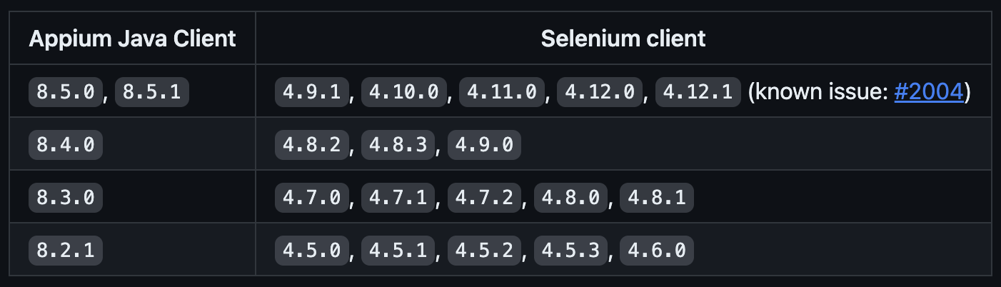
Appium Capability Matrix together with Selenium?

Slide 7
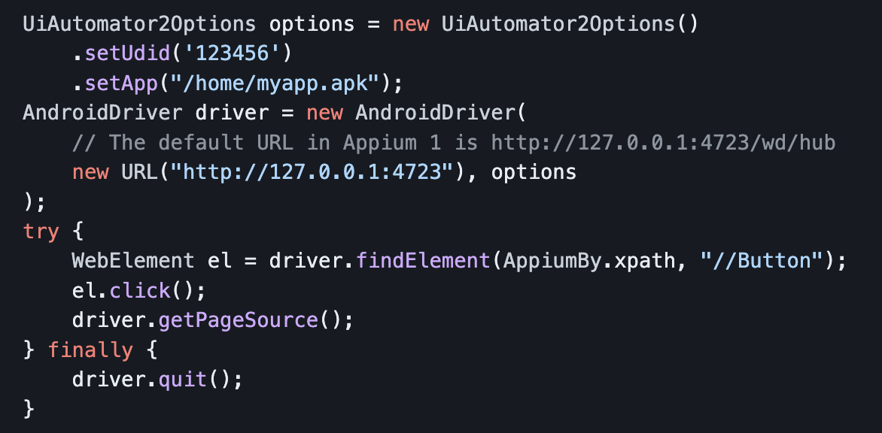
Appium Test Structure
For Android devices we are using UiAutomator2 Driver. So we need to provide options and URL on which our driver object will be created.

Slide 8
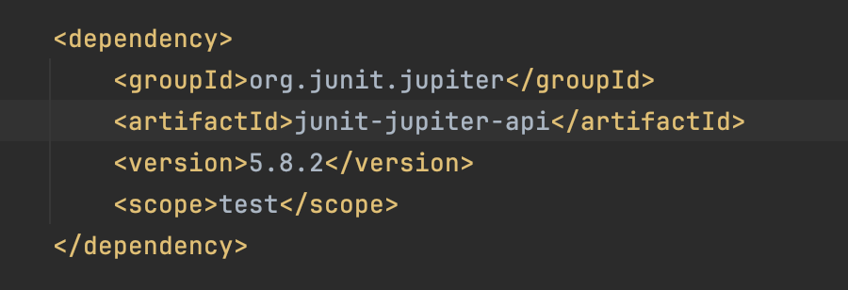
Junit Jupiter for Test Management
Appium Tests can be written as Cucumber scenarios (BDD format) or can be managed with any unit testing tool such as TestNG or Junit.

Slide 9
Installation of Tools Required

Slide 10
MacOS and Windows Tools and Check Up
JDK version 8 or a later version needs to be installed and JAVA_HOME needs to be setup.
java –v
Install NodeJS (latest LTS as of today).
node –v. and npm –v
Install Android Studio and run the emulator.
Install Appium Server and run the server.
Start Appium Inspector for locating elements.
Detailed Instructions on installation is provided as separate PDF files and videos for both MacOS and Windows.

Slide 11
Writing and Running Tests

Slide 12
Create a Maven Project Project
We need to create a Maven Project and select our Java JDK to be at least 11 or more.
Need to create a testing framework structure with elements such as;
Utils, pages, tests packages
Driver, ConfReader and Prop. Files
Application apk that will be used for testing
pom.xml file dependencies needs to be defined.

Slide 13
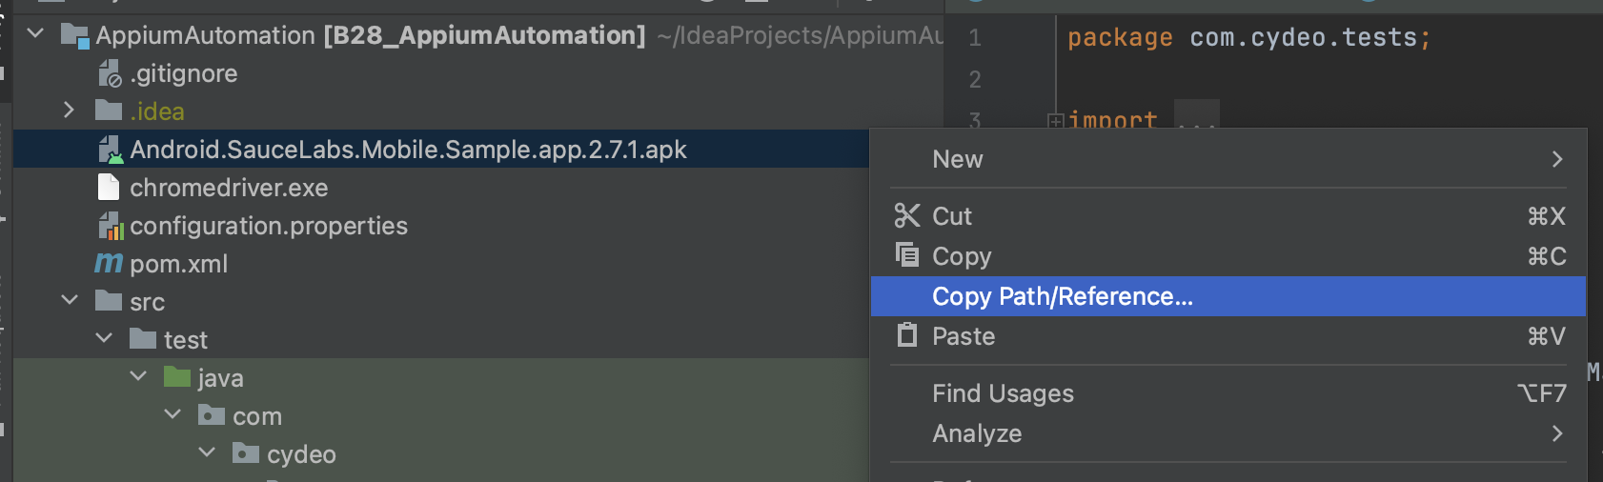
Testing a Native App
You can provide your application which is under Test as a file in two ways;
Cloud Services
Inside your test framework
Provide the URL of the location where the application is;
https://cybertek-appium.s3.amazonaws.com/calculator.apk
Provide the path of the application under test in your framework.

Slide 14
Testing WebApp on Mobile Browsers
We need the drivers of browsers for testing
two ways;
Locate version and provide with path
Allow appium to download and install
Whichever browser is going to be used, we can identify the version and download necessary driver, then provide the file path to Appium
Or we can let Appium do the magic for us with following command:
appium --allow-insecure chromedriver_autodownload

Slide 15
Using Cloud Services for Mobile Testing

Slide 16
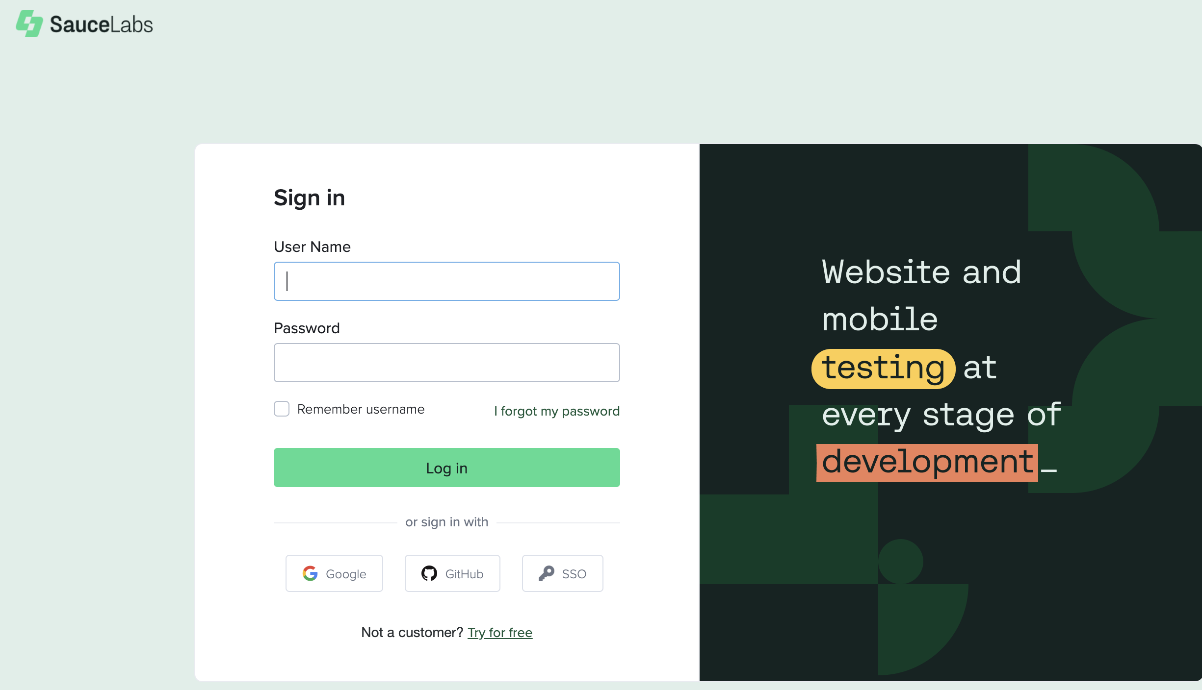
Saucelab for Mobile Testing
You can easily open a free Saucelab account by using your Google account.
Saucelab provides free credits to execute testing by using their Appium server and virtual/real mobile devices.
Tests are recorded in their server, you can reach test videos or screenshots easily and provide them to your team mates.

Slide 17
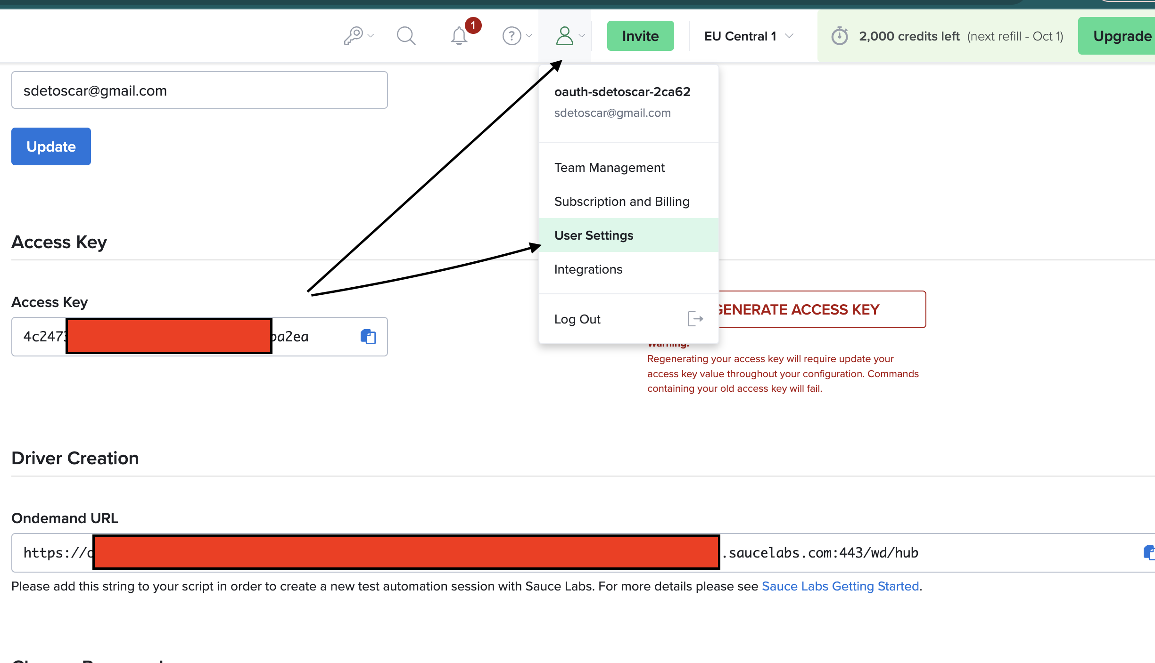
Saucelab for Mobile Testing
You will need your personal URL. This Url will be used when the automation driver is created.
You need to click on man icon then User Settings tab.
Ondemand URL is your personal URL that you will need to run tests remotely on Saucelab.
For this type of testing you don’t need to install Appium server or Anroid Studio etc. All you need is your Appium client.

